Slide 1


The Bread Basket
Bakery Shop

Slide 2


The Bread Basket
Bakery Sales Performance Dashboard
An Interactive Analysis of Customer Trends and Product Insights
By: Deepa Nayak
Date:

Slide 3



The Bread Basket
Project Overview
Content:
Industry: E-commerce & Retail
Dataset Source: “The Bread Basket” Bakery, Edinburgh
Time Period: 30 Oct 2016 – 09 April 2017
Goal: Analyze sales trends, customer behavior, and recommend business strategies

Slide 4



Dataset Description
The Bread Basket
20,507 rows | Over 9,000 unique transactions
4 main columns: Transaction, Item, date_time, period_day
Data collected from online orders
Derived fields: Hour, Day Name, Month, weekday_weekend

Slide 5


Data Cleaning & EDA (Python)
Tools: Jupyter Notebook, Pandas, Seaborn
Cleaned nulls and duplicates
Extracted time-based features (Hour, Date, Day_Name, etc.)
Created weekday_weekend & period_day
Saved cleaned data as Excel for further use
The Bread Basket

Slide 6

Initial Exploration
in Excel
Created PivotTables to analyze:
Top-selling items
Sales by period of day
Weekday vs Weekend transactions
Slicers for Month and Day Name added for interactivity
Provided base structure before moving to Power BI
The Bread Basket

Slide 7


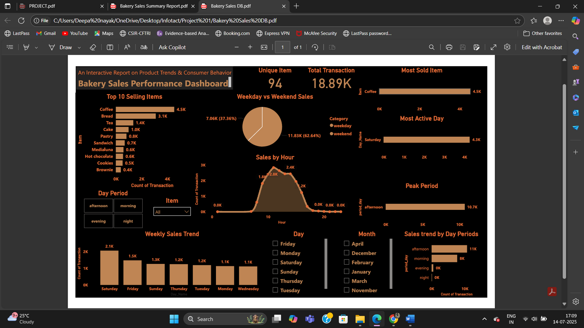
The Bread Basket
Dashboard in Power BI
Interactive dashboard with:
5 KPI Cards
Charts: Bar, Column, Line, Donut, Treemap
Slicers: Month, Day, Period, Item
Insights directly driven from visual exploration

Slide 8


The Bread Basket
Coffee is the most popular item
Weekends & mornings show higher traffic
Midday has peak transaction volume
December shows seasonal demand spike
Top 5 items dominate sales
Key Insights

Slide 9


The Bread Basket
Final
Recommendations
Stock more Coffee and Breakfast combos early
Prepare for seasonal peaks in December
Increase weekend staffing
Launch tea-time offers (3–5 PM)
Implement a simple loyalty system

Slide 10

The Bread Basket
Thank You

